Slide 1
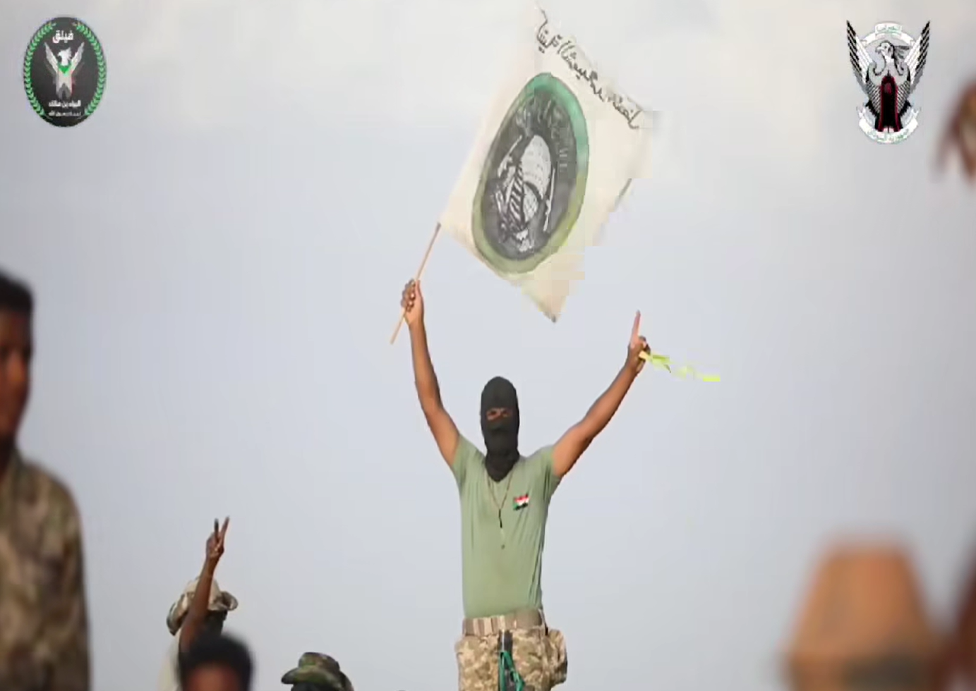
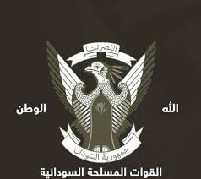
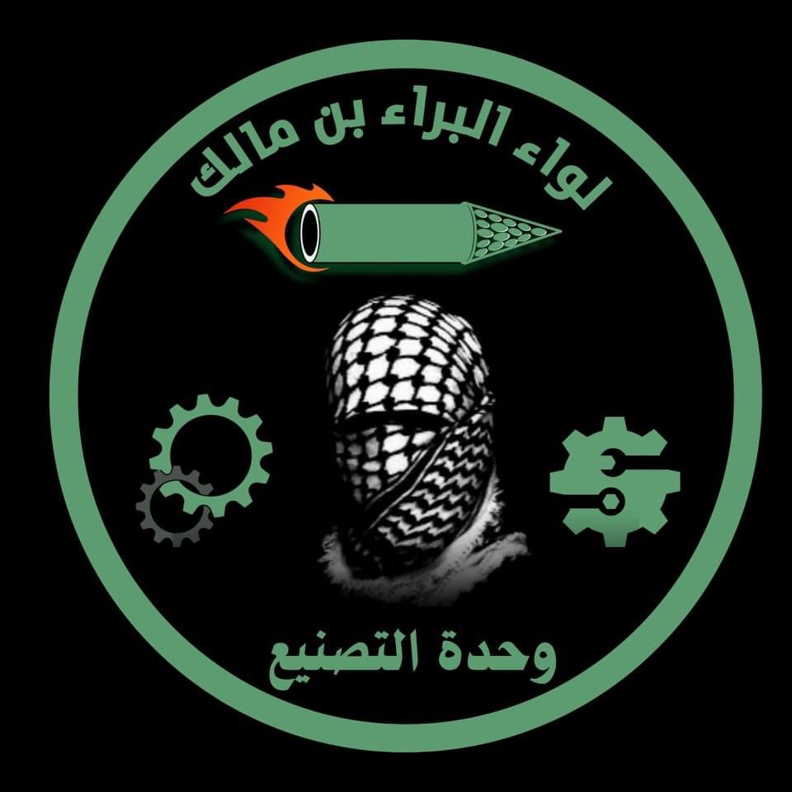
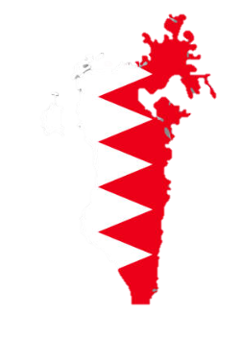
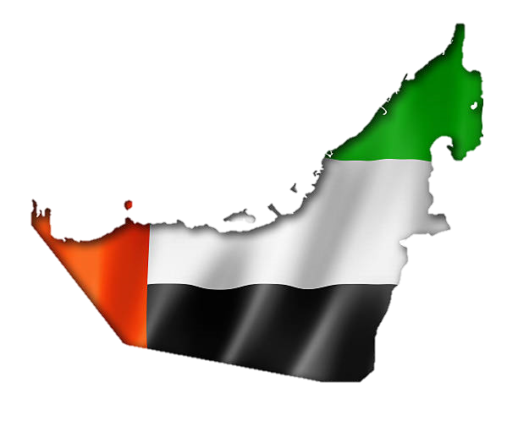
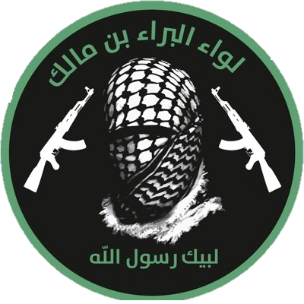
What?
Militant Jihad in the Civil War in Sudan
Where?
Sudan
How?
Civil war
What is the report’s significance?
Who?
SAF
RSF
Background on the Civil War in Sudan
Review of recent developments in the war
Geopolitical analysis of foreign actors' involvement
Review of militant jihadi activity in Sudan
Analysis of Al-Bara’ ibn Malik Brigades and its IMA and social media activity
What?
How?
Financial recruitment and militant propaganda
IMA activity
Where?
Saudi Arabia
Bahrain
UAE
What is the report’s significance?
Analysis of Al-Bara’ ibn Malik Brigades IMA activity
Collection and analysis of identifiers of individuals from Saudi Arabia, Bahrain and the UAE who are members of Al-Bara’ ibn Malik Brigades IMA groups
Who?
Al-Bara’ ibn Malik Brigades

Slide 2
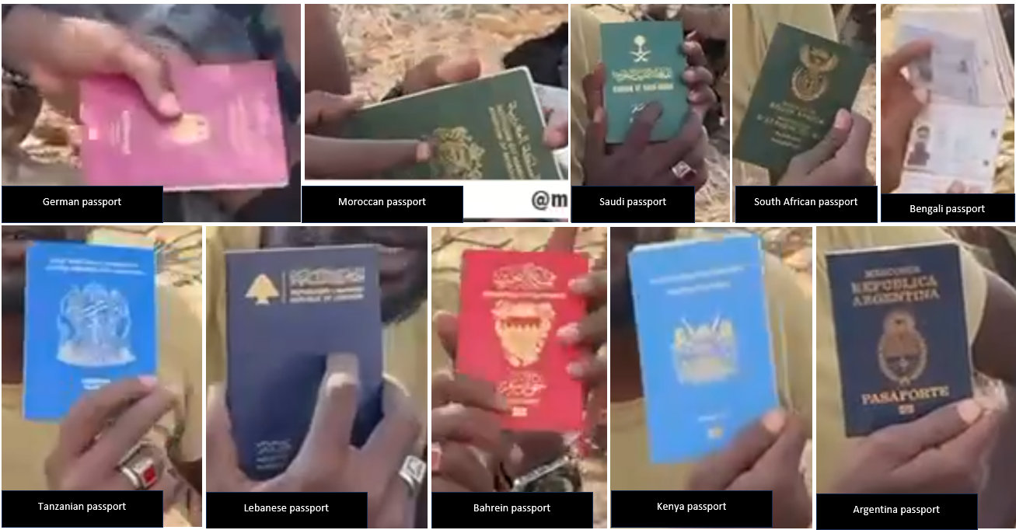
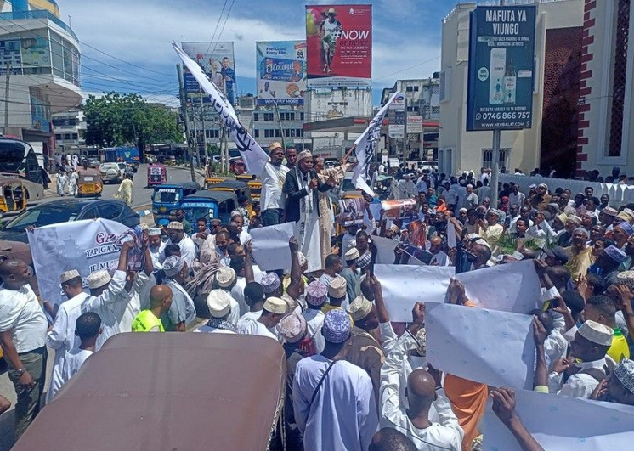
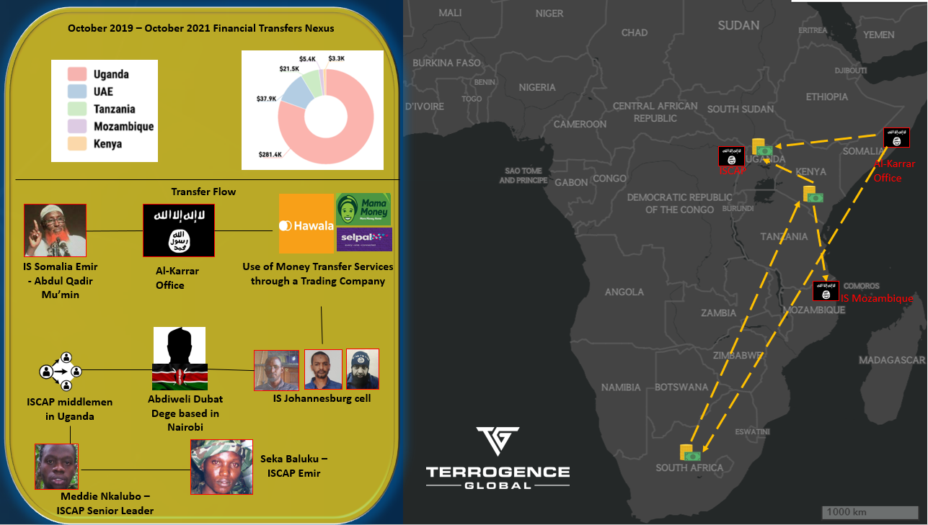

Slide 3
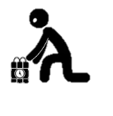
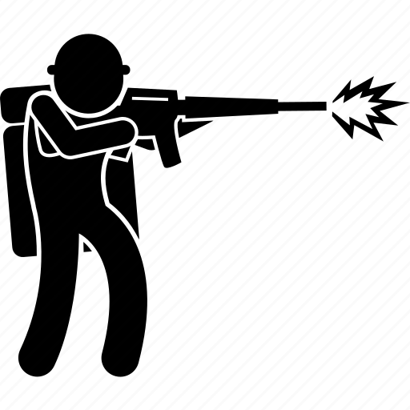
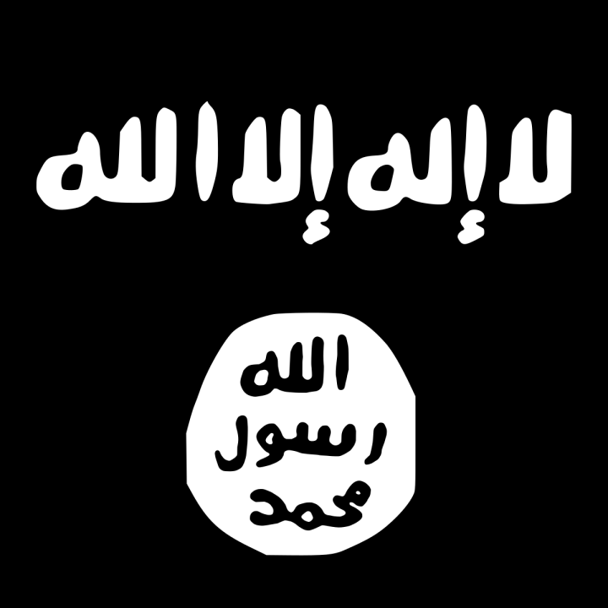
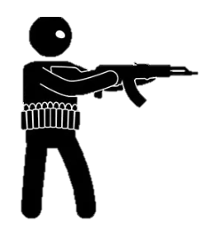
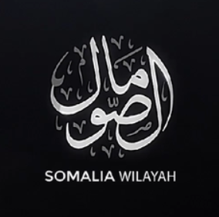
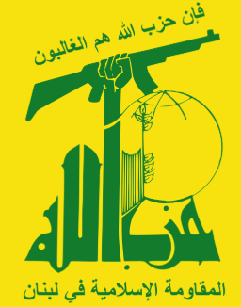
What?
How?
IEDs, vehicle-ramming and shooting attack
Lone wolf terrorist attack
Where?
New Orleans, USA
What is the report’s significance?
Timeline of the attack analysis.
Insights on weapons and tactics.
Overview of inciting messages and reactions in IS channels.
Exposes identifiers of a militant jihadi adherent in the USA and his conversation with an Iraqi IS propaganda operative.
Who?
Shamsud-Din Bahar Jabbar acted alone on behalf of the Islamic State
What?
How?
Inghimasi raid with PBIEDs, SVBIEDs and firearms
Raid and suicide bombing
Where?
Puntland, Somalia
What is the report’s significance?
This style of attack is unusual for IS-S.
Demonstrates the capabilities and training of foreign recruits by IS-S.
Validates the foreign fighters’ countries of origin.
Outline of the Al-Karrar office activity.
Exposes identifiers of IS adherents in Morocco.
Who?
The Islamic State in Somalia (IS-S) - foreign fighters from Morocco and other places
What?
How?
Money laundering and illicit financial activities
Hezbollah financial nexus
Where?
Kinshasa, Democratic Republic of the Congo (DRC)
What is the report’s significance?
Preliminary thoughts on the financial situation of Hezbollah in the aftermath of Operation Northern Arrows.
Examines Hezbollah activity in the DRC.
Exposes identifiers and details of a Lebanese national who holds a managerial position in an entity sanctioned by OFAC.
Who?
Lebanese Hezbollah

Slide 4
What?
How?
s
R
Where?
P
What is the report’s significance?
T
Who?
I

Slide 5
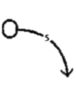
Vector Images

